Slide 1

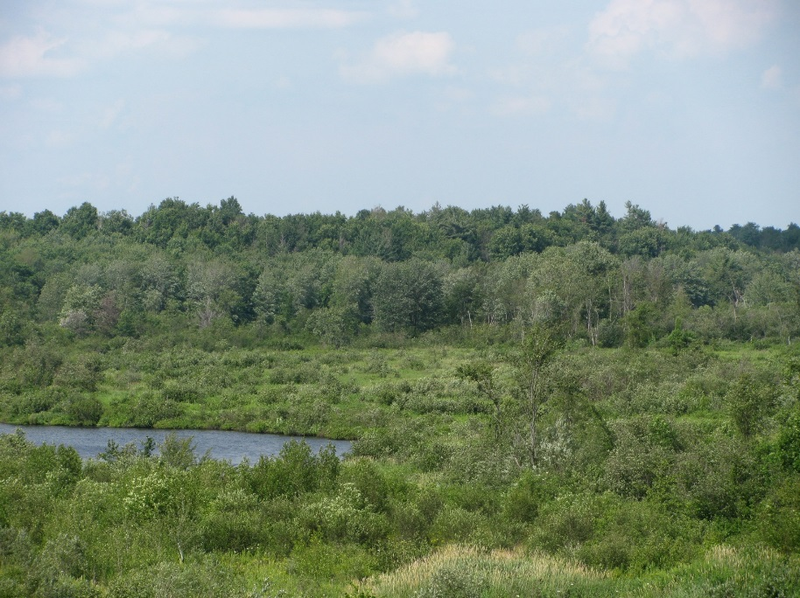
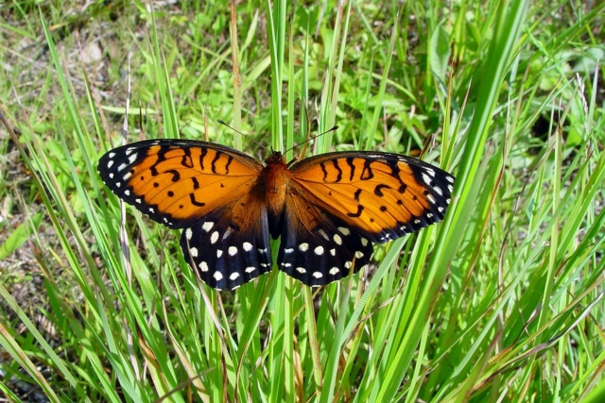
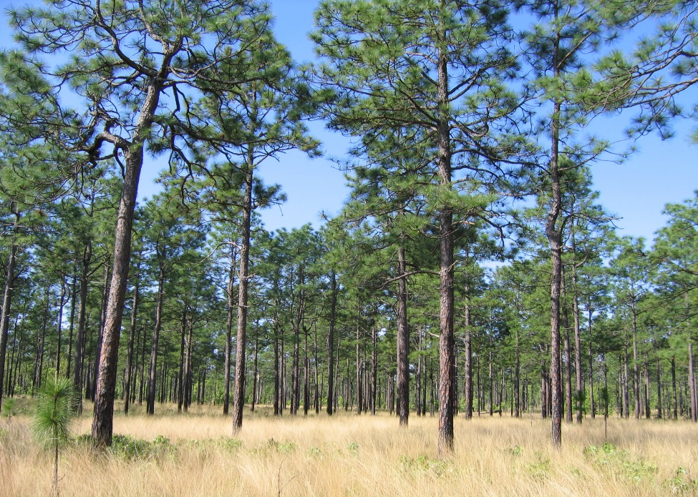
Federal Natural Resource Division

Slide 2
Federal Natural Resource Division
Beau Long – Federal Operations Director
Started in Vegetation Management in 1984
Utilities, Forestry, Aquatics, Rangeland
Dick Shampine – Senior Military Consultant
Air Force / ANG Pilot for 28 years
Air to Ground Range Officer at Ft. Drum 1975 - 1998

Slide 3
Federal Natural Resource Division
Project was first started in 2004
Started working as a team in 2008
CPS team members have done service work or sold product at over 30 different installations
Initiated 2007 & 2010 congressional surveys highlighting vegetation impediments to training

Slide 4
Who is CPS
• CPS is a global company specializing in both crop and
non-crop vegetation management.
– Specialty business units focusing in:
• Vegetation Management, Forestry & Aquatics
• Government Business Development
• Turf & Ornamental
• Manufacturing – including herbicides, surfactants, insecticides &
fertilizer production “Loveland Products”
• We have a strong national presence across the United
States with more than 8,500 employees and over
14,000 employees worldwide .
• CPS is the largest national distributor in the US with an
annual gross sales of more than $10 billion
• 850+ warehouse locations across the United States

Slide 5
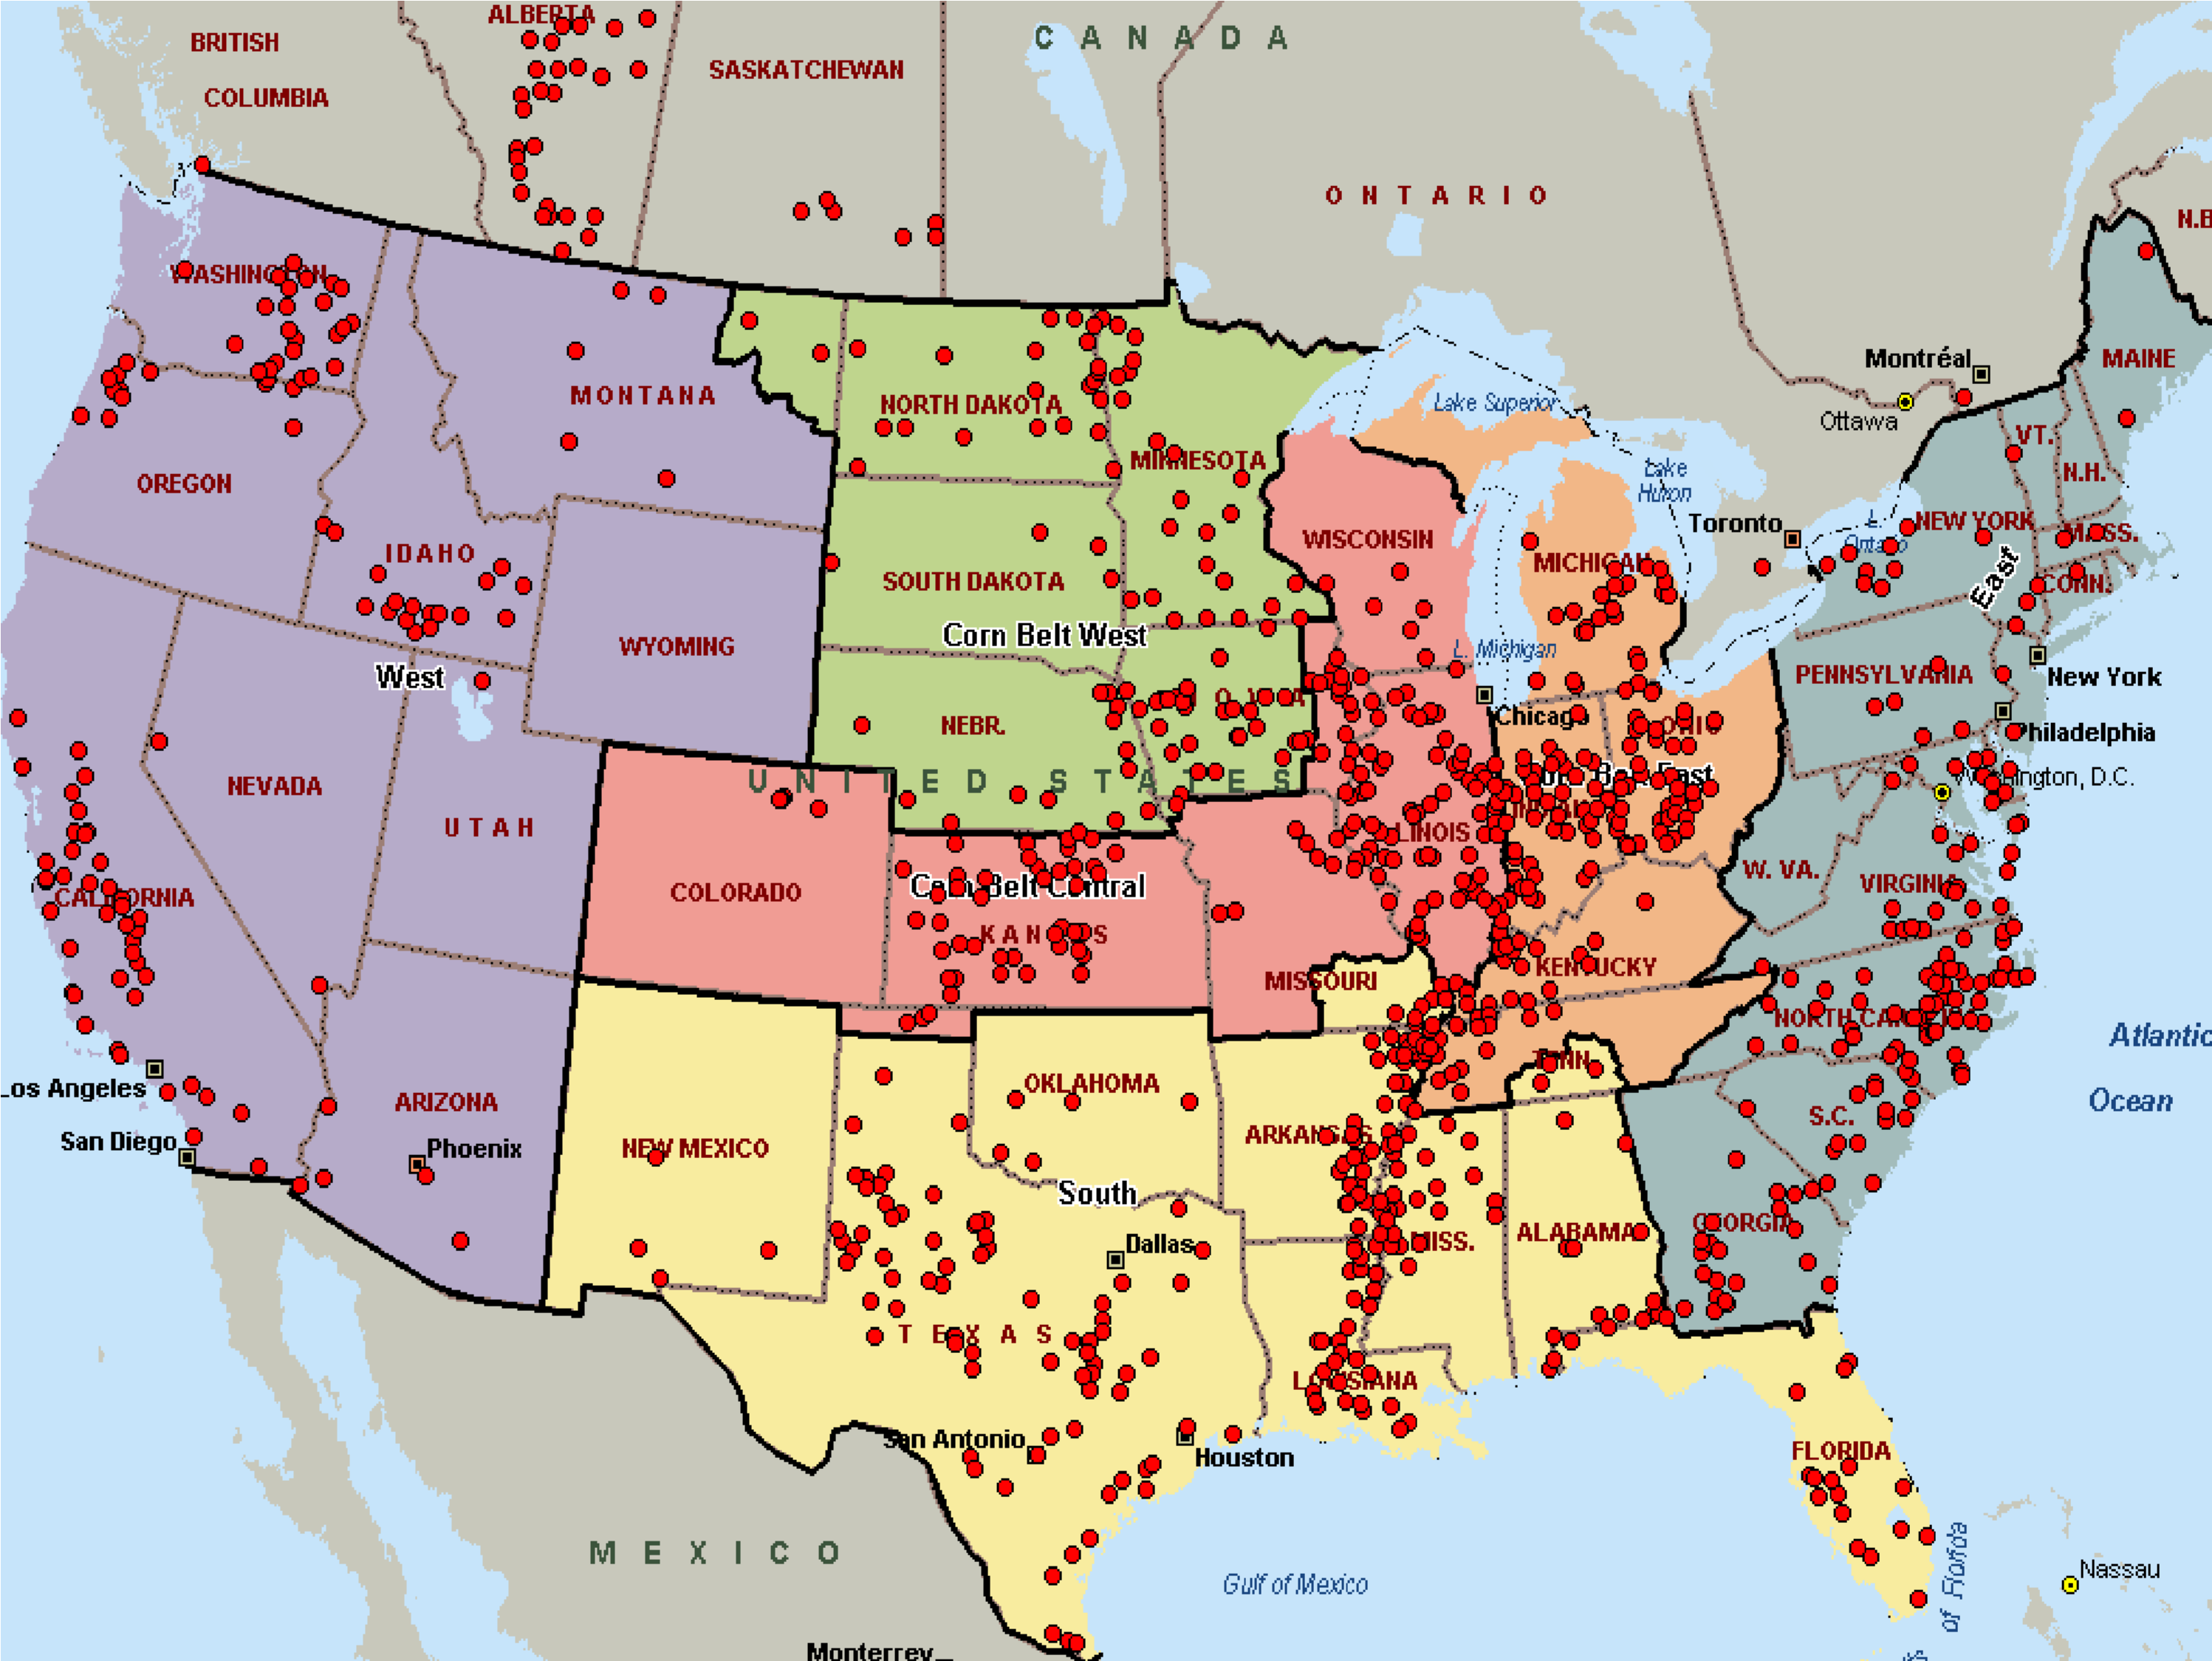
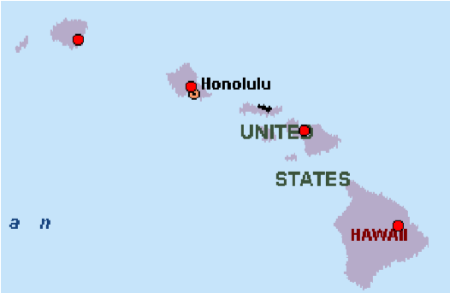
All Locations
CPS Warehouse Locations – US and
Updated 2/4/10
Canada
Points shown include fertilizer storage and similar support locations.

Slide 6
2012 – 2014 Installation Programs
Northeast |  | Southeast |  | Other
Fort Drum |  | Fort Stewart |  | Fort Campbell
West Point |  | Fort Gordon |  | Fort Sill
Fort Devens |  | Fort Jackson |  | Texas Army Guard (Camp Swift)
Tobyhanna Army Depot |  | Fort Pickett |  | Fort Hood
Fort Indiantown Gap |  | Fort Eustis |  | Fort Hunter Liggett
Fort AP Hill |  | Fort Lee |  | Schofield Barracks
Fort Bragg |  | Camp Blanding |  | Fort Huachuca
Moody AFB |  | Blue indicates 2 or more continuous years

Slide 7
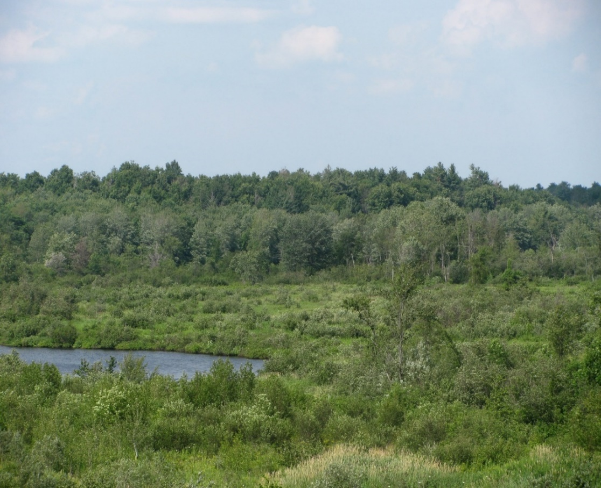
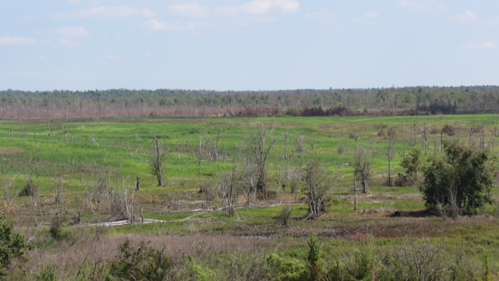
OP 9, Fort Drum, PRE and post Treatment, 2007 to 2014
Lost targets due to vegetation overgrowth
This area has been treated twice over a period of 7 years

Slide 8
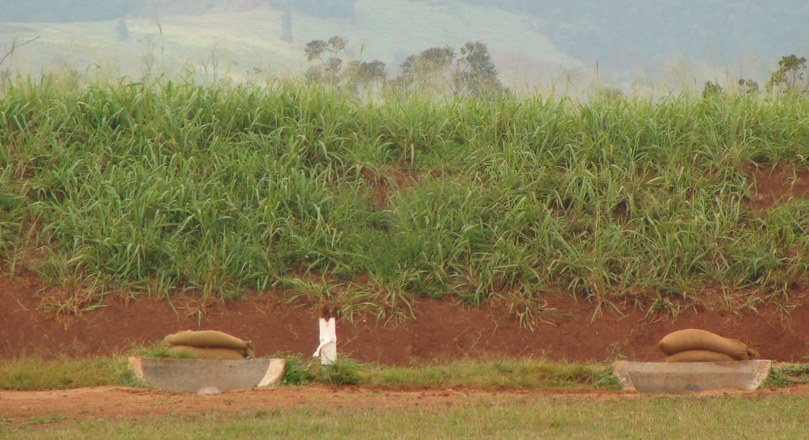
Invasive Species: Guinea Grass, Medusahead rye, Cheatgrass, fragmities, etc.

Slide 9
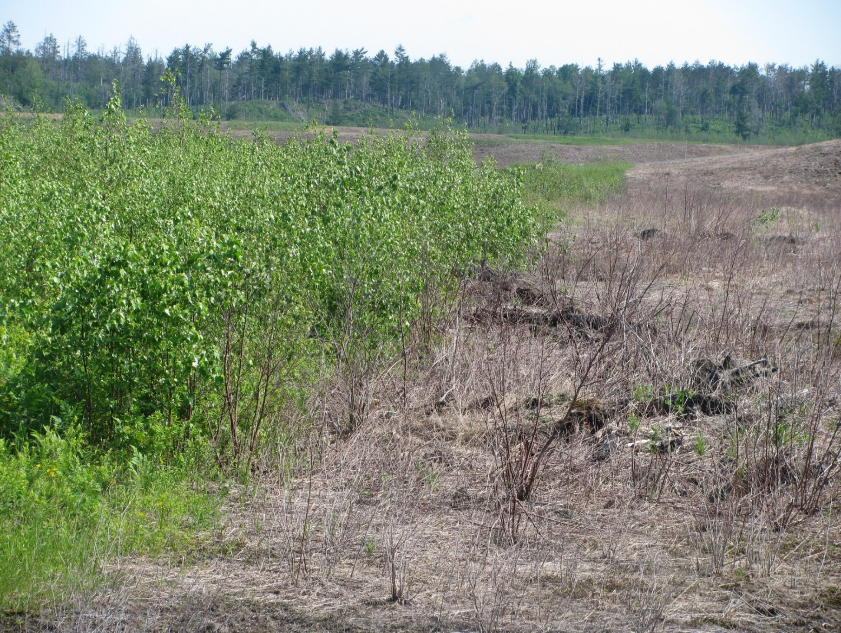
Accu-Flo Nozzle
Accu-Flo Nozzle
Designed for helicopter / aircraft delivery systems
Uniform size droplets
Can be used for most applications
Provides consistent, dependable, accurate drift control

Slide 10
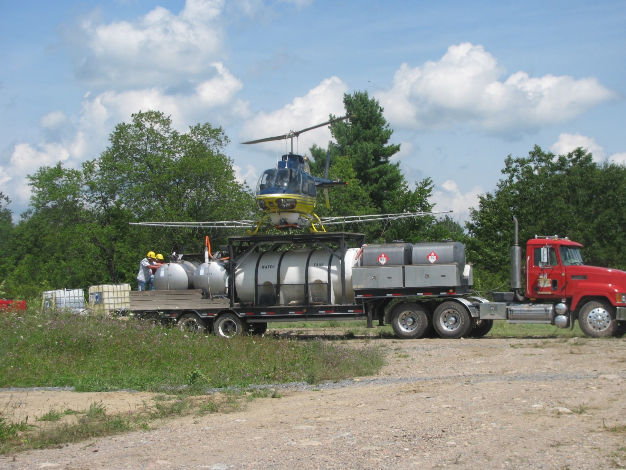
Batching Operations
Batching Operations
Self contained system
Mobile
BMP (Industry Standard)
Cost Efficient
Cost Per Acre + or - $300

Slide 11
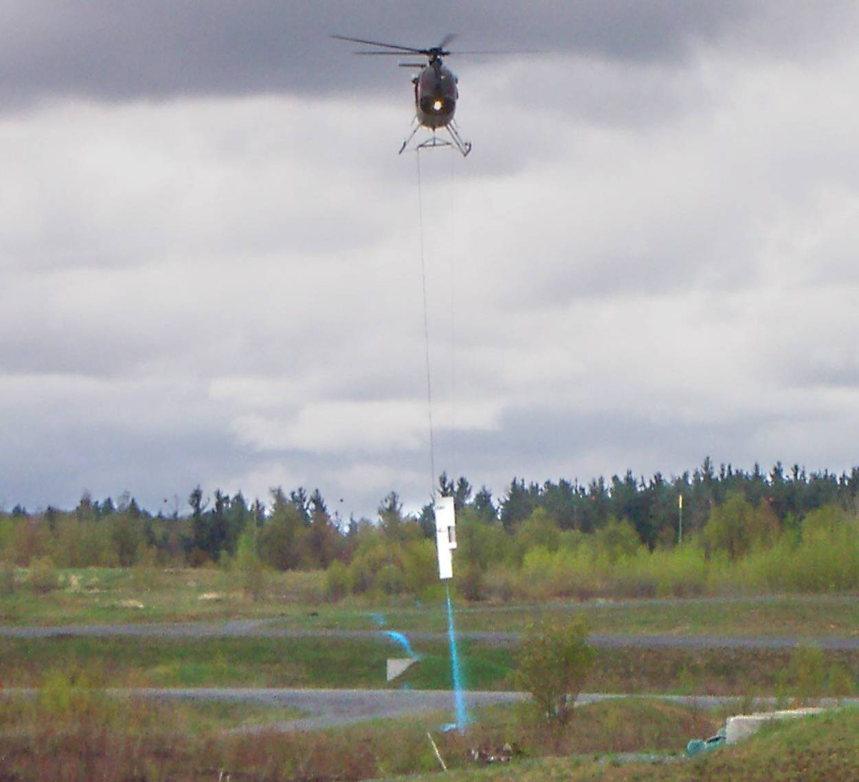
Ft Drum – TimberMark System
TimberMark
Capable of translating GIS inputs into lines on the ground, making the invisible lines visible.
Provides one more layer of credibility for project managers responsible for public affairs.
Utilizes Nelson tree marking paint for marking operations.
The same pilot that does the painting applies the herbicides, thus providing one more layer of awareness within the spraying operation.

Slide 12
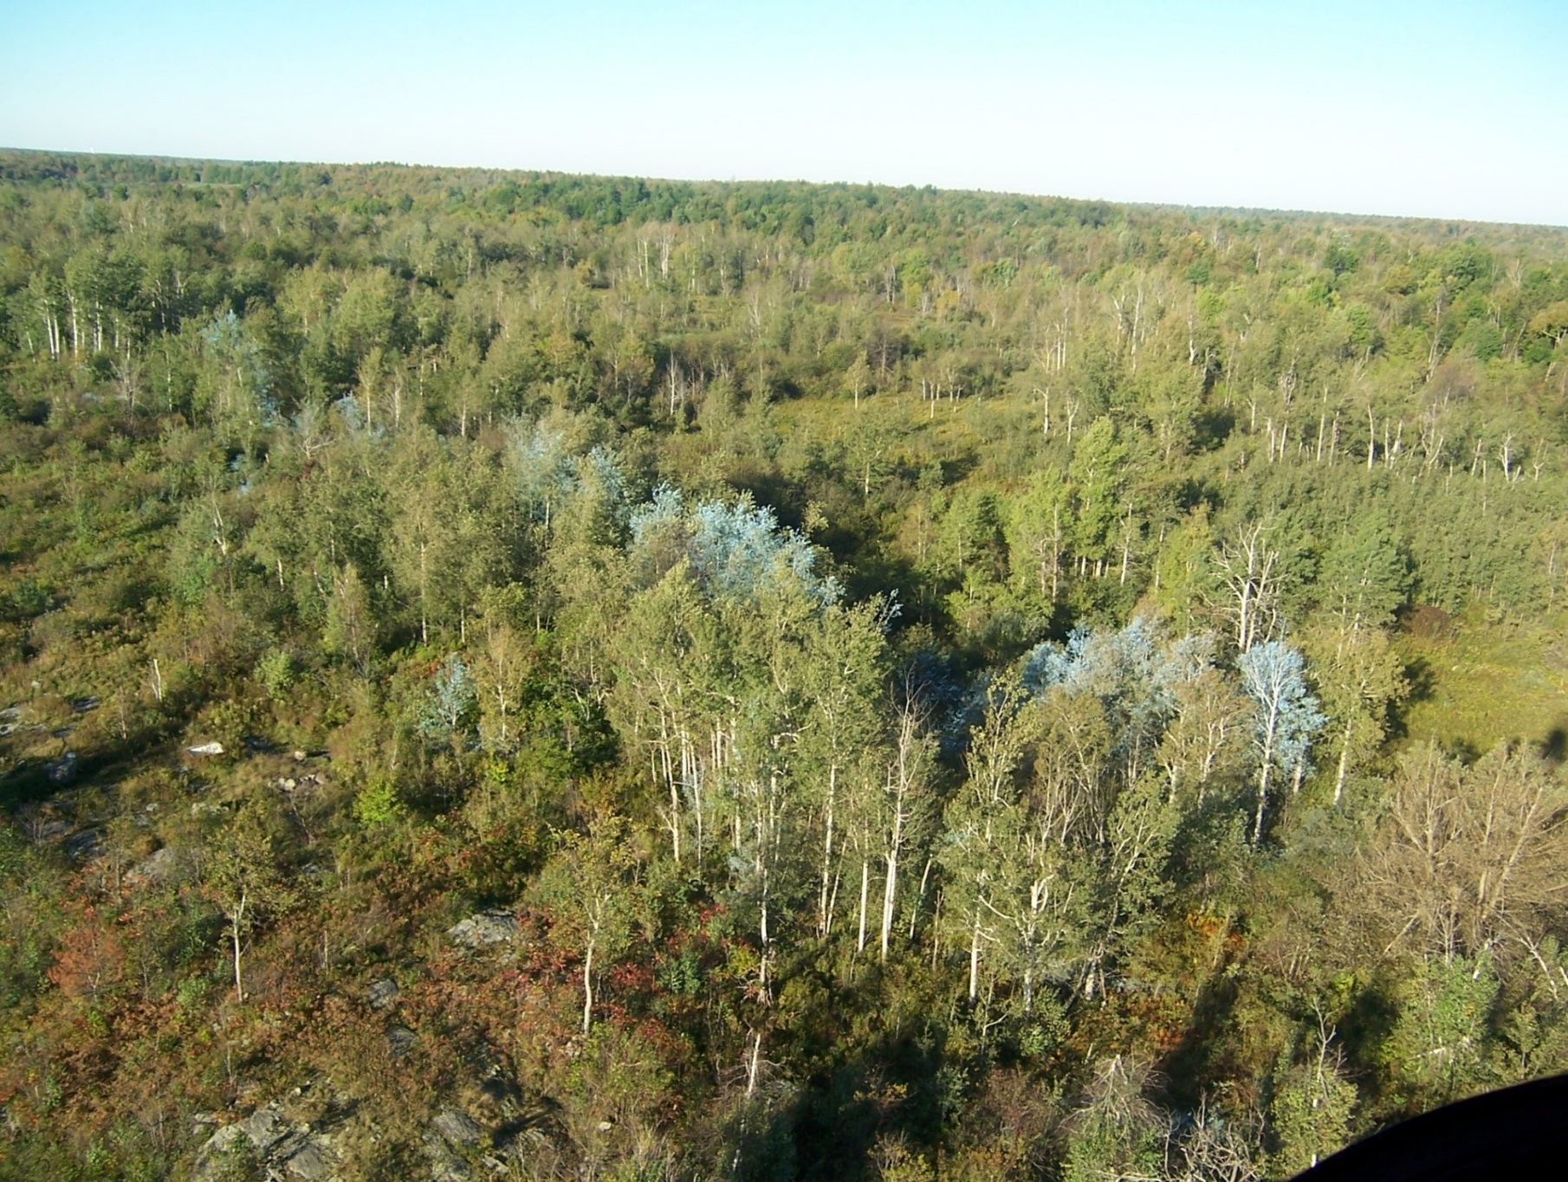
Ft Drum – TimberMark Delineation
TimberMark Delineation
Paint used to delineate area to be sprayed.
Paint is designed to last one year.
Requirement for use is written into the Ft. Drum Environmental Assessment.

Slide 13
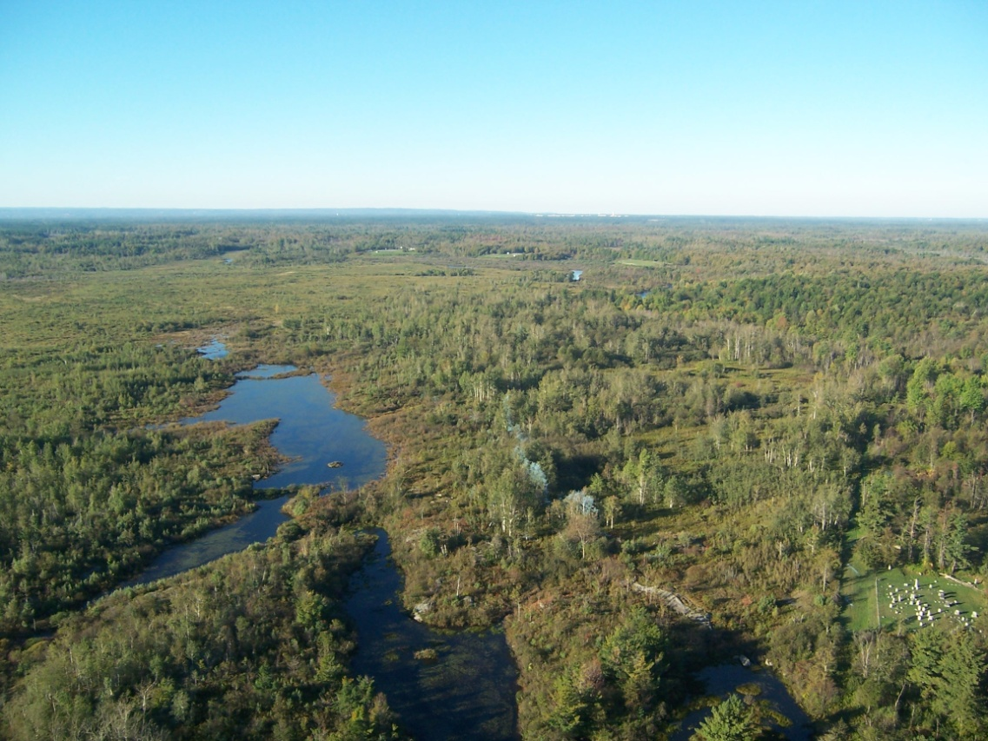
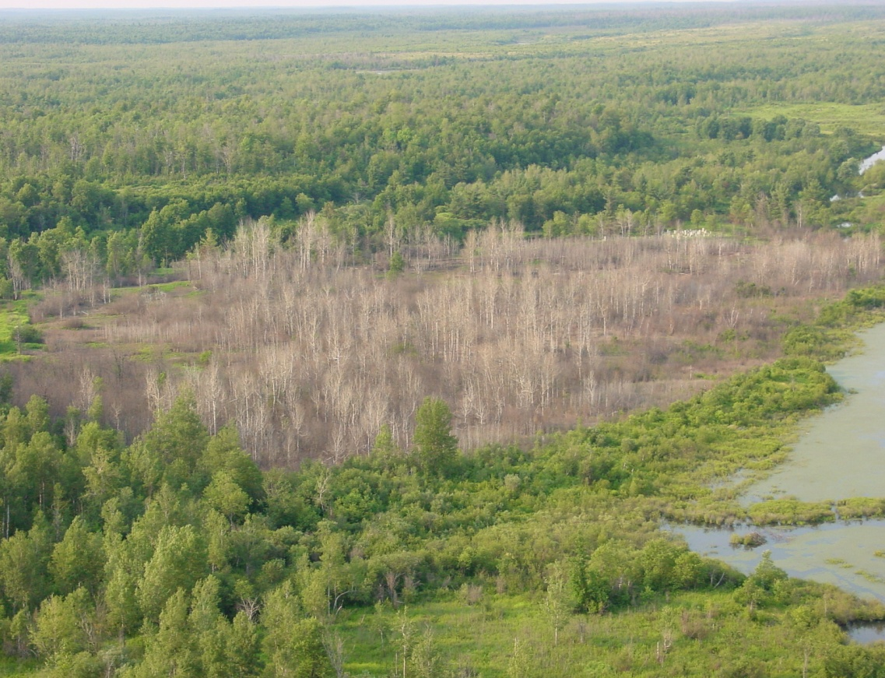
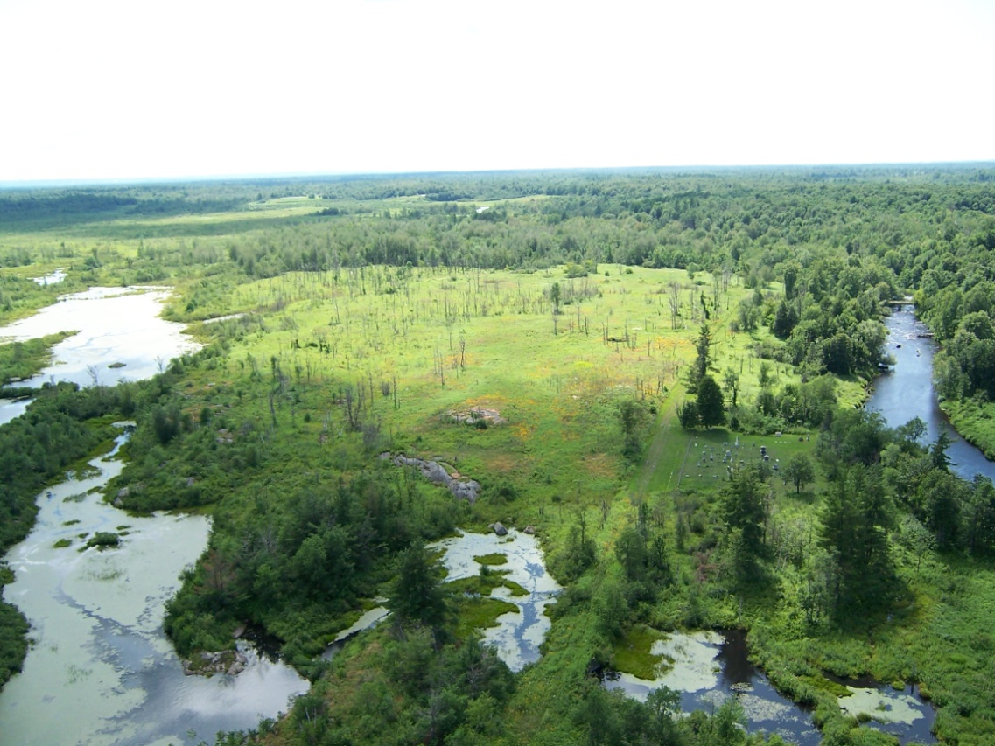
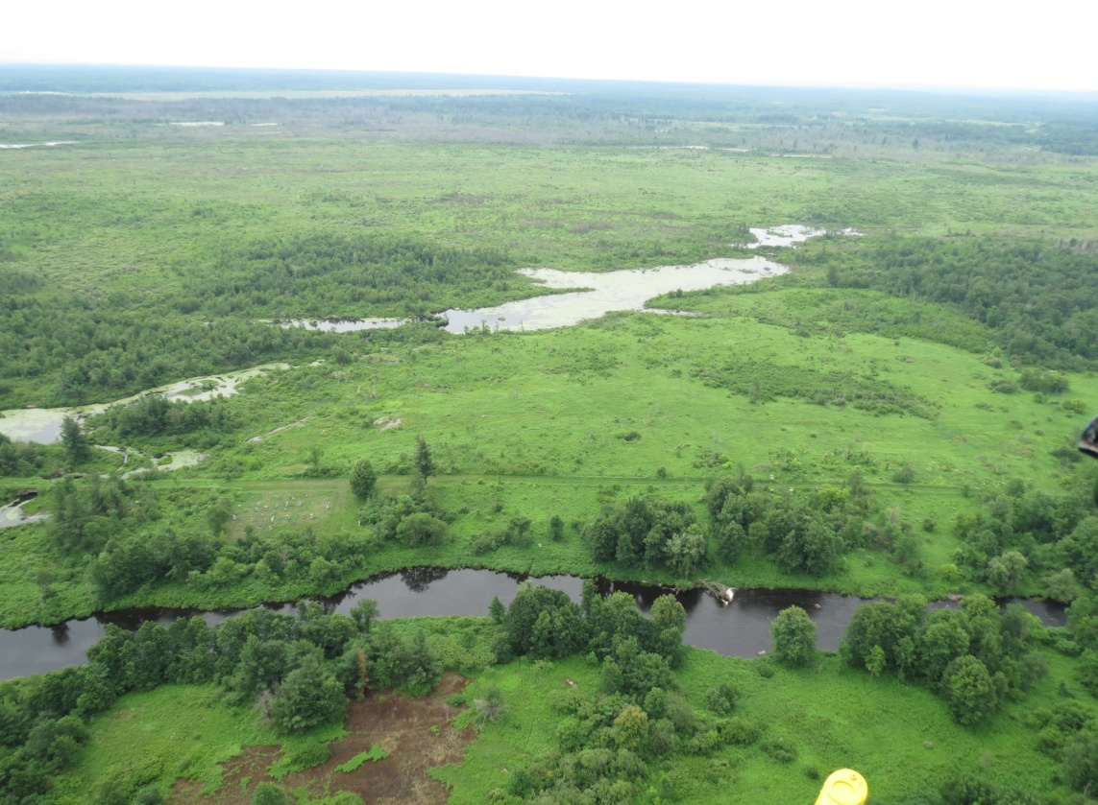
Pre-Treatment October 2005
Post Application July 2006
Ft Drum OP 6A
July 2009 – 3+ years after Treatment
July 2013 – 8 years after Treatment

Slide 14
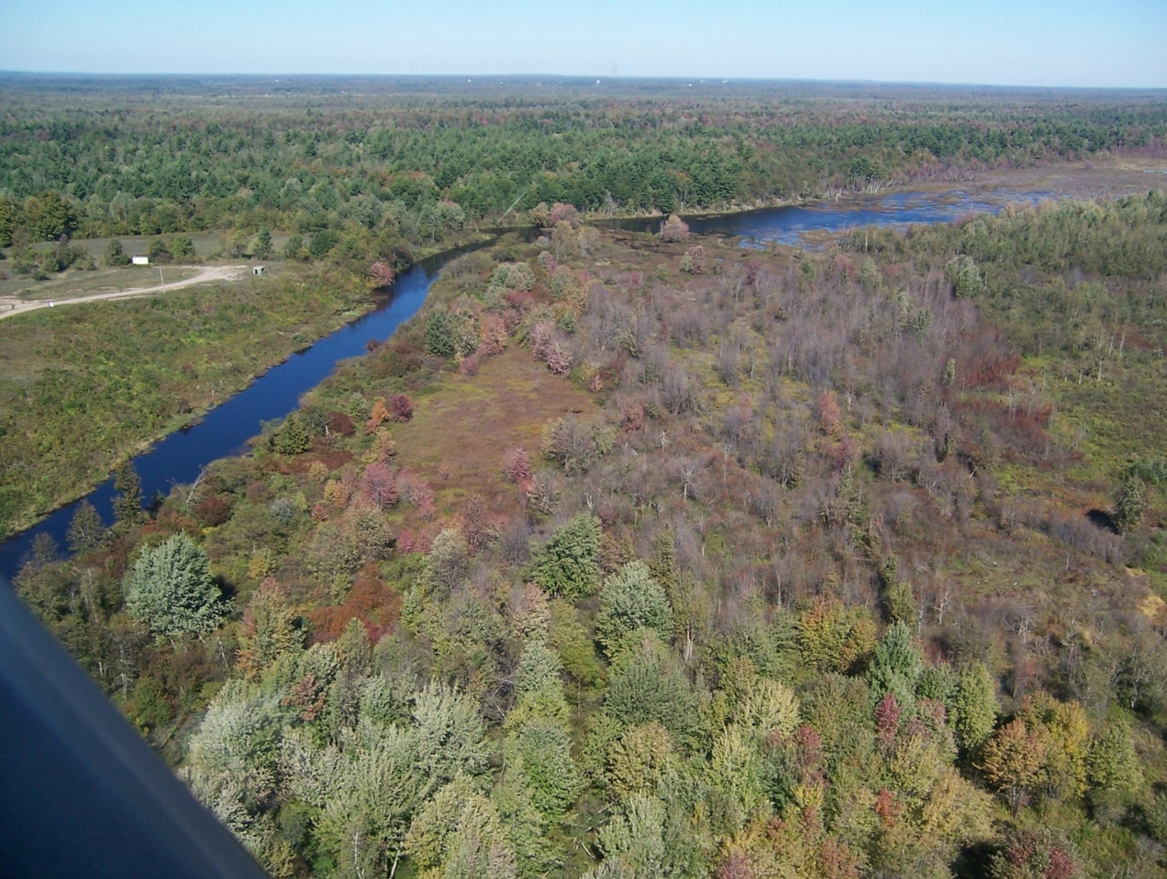
Treatment Area
Post treatment view
Riparian zone along river.
Ample fuel load for burn (when desired).
Uniform control throughout the treatment area.

Slide 15
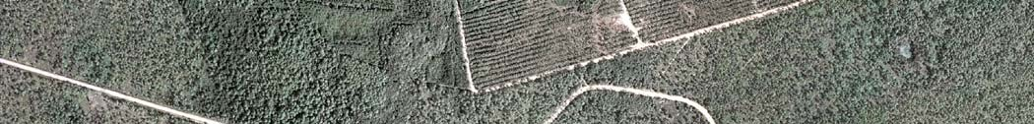
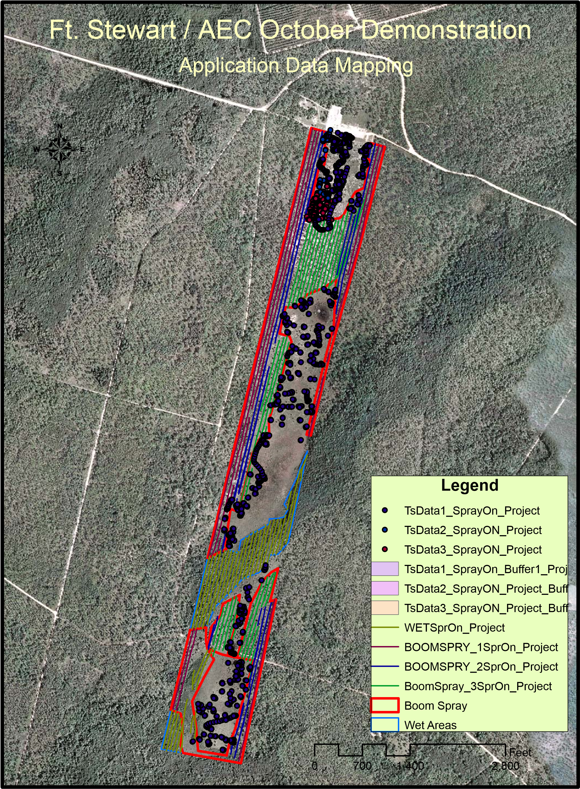
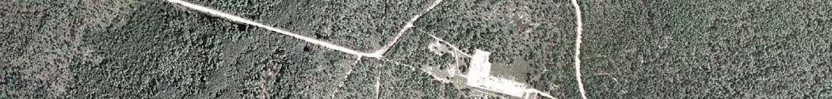
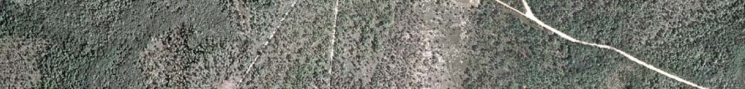
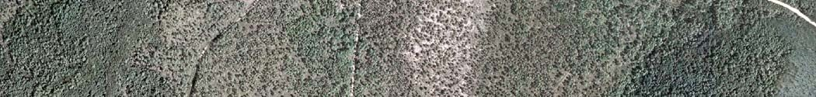
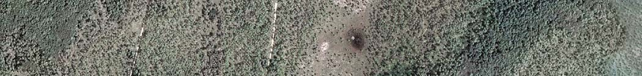
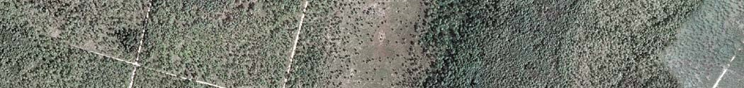
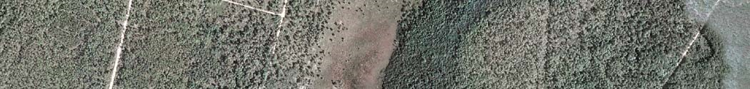
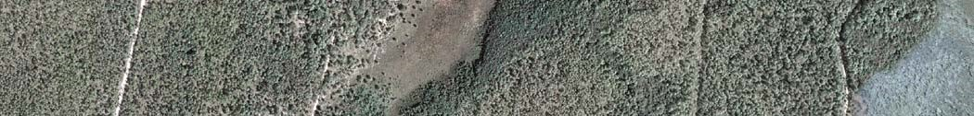
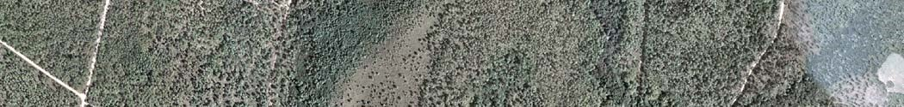
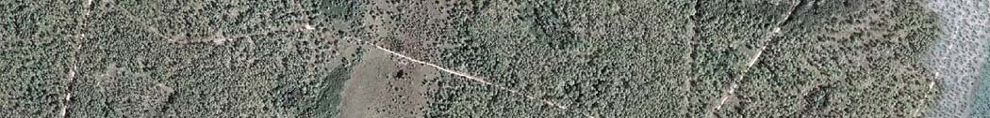
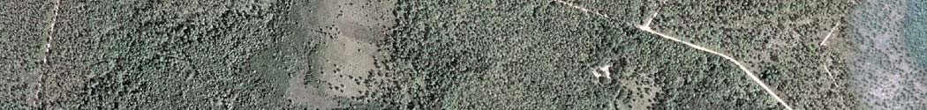
Ft. Stewart / AEC October Demonstration
Provided Data
4
Legend
AGRIspray
0
Feet
2,800700
1,400

Slide 16
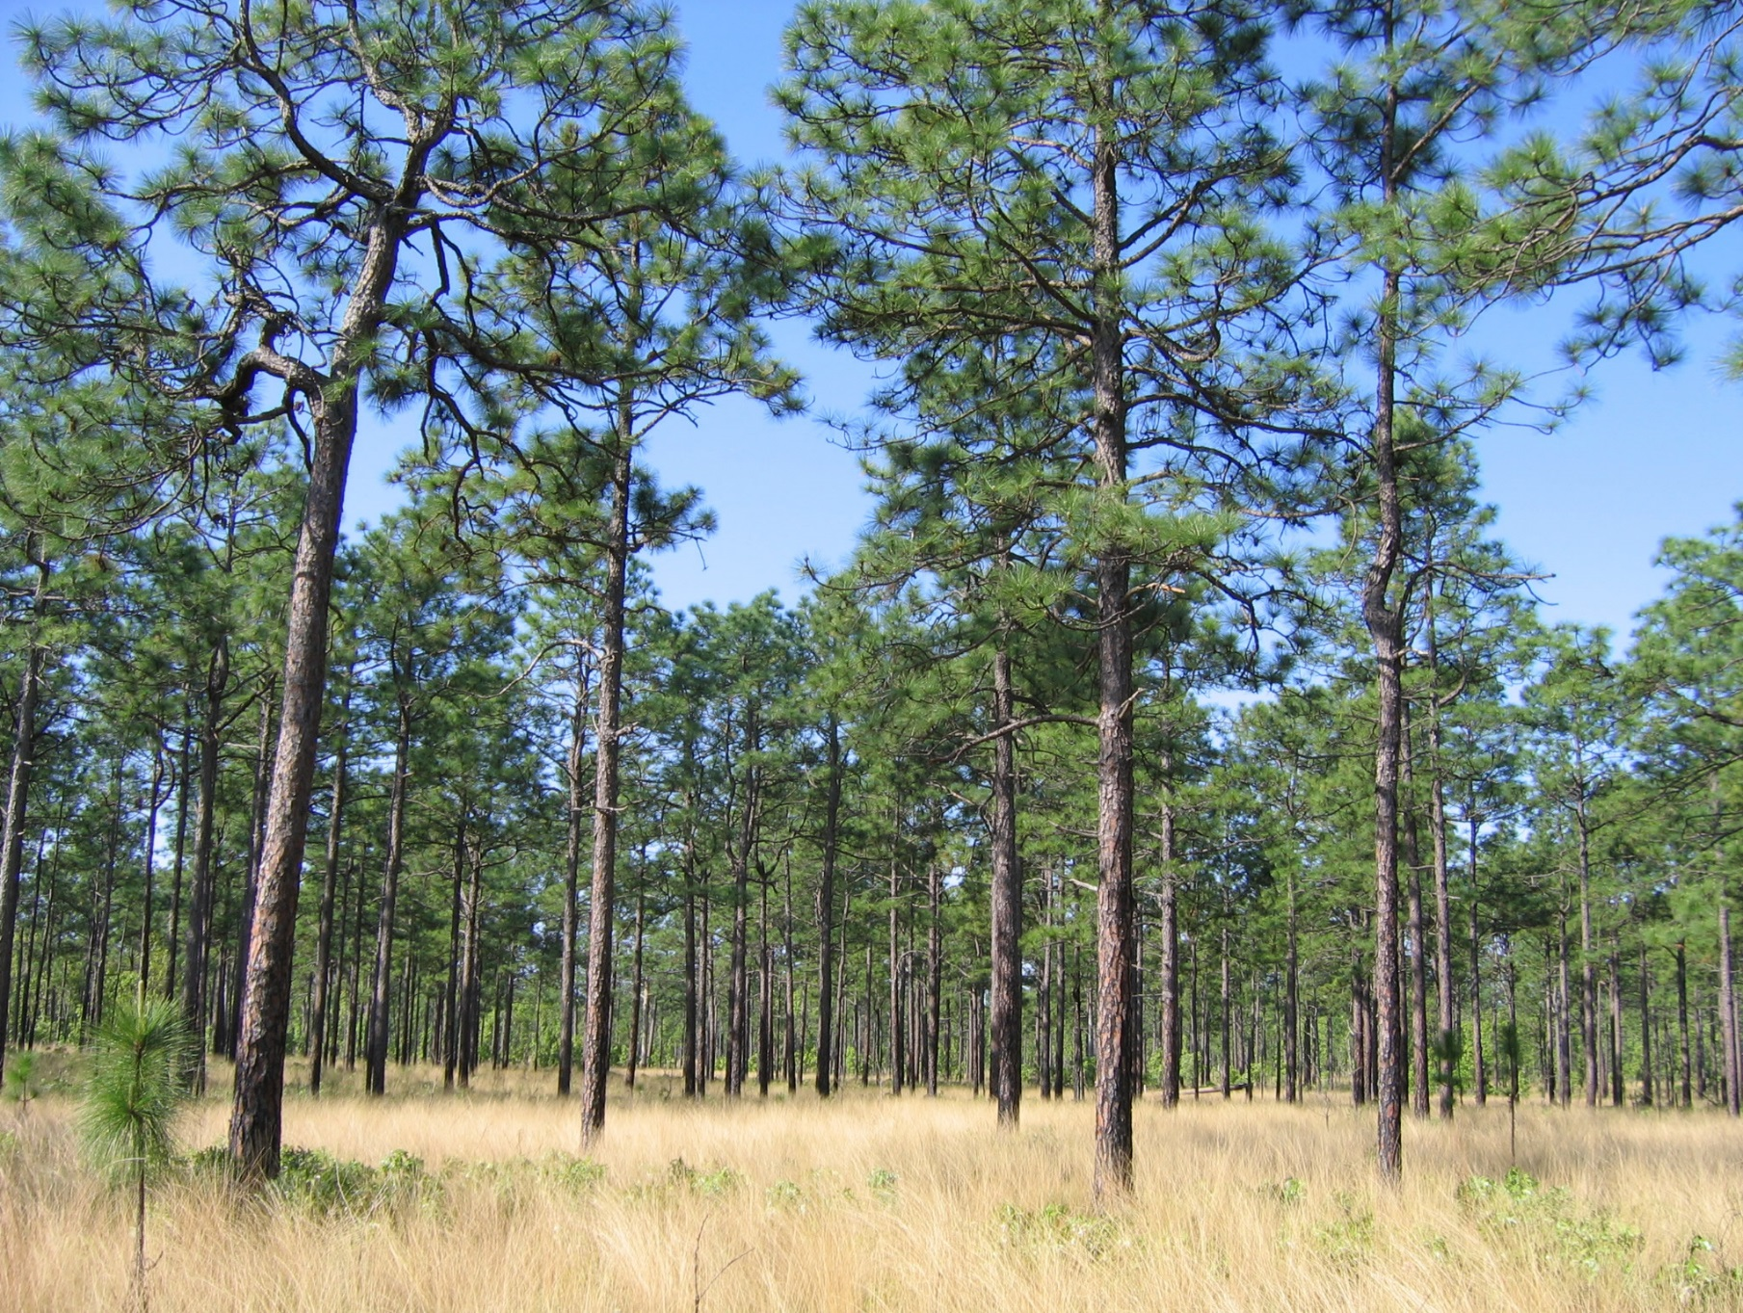
Red Cockaded Woodpecker Habitat Restoration (Endangered Species)
DoD directed RCW recovery operations
Ft Benning
Ft Stewart
Ft Gordon
Ft Bragg
We have previously worked on or are currently working at all of the above installations.
Due in part to herbicide treatments, the DoD has met its quotas and is now providing nesting pairs to other governmental agencies.

Slide 17
Environmental Considerations
Measures of Merit
MoM #1: All DOD installations will have a current Pest
Management Plan.
MoM #2: DOD will adhere to the principles of Integrated Pest
Management (IPM) and maintain the goal of minimizing
pesticide usage. The goal is 425,000 lbs of active
ingredient per year, the DOD’s average annual usage for
FYs 2007-2009 and an overall 52% reduction from the original FY 1993 baseline.
MoM #3: All pesticide applicators will be certified.

Slide 18
Environmental Considerations
Armed Forces Pest Management Board (AFPMB)
AFPMB approved the list of chemicals that can be used on DOD installations.
Army Environmental Command (AEC) approves
  All chemicals used on Army Installations.
  The application methodology used on Army Installations.
    Ground Applications.
    Aerial Applications (normally reserved for impact areas).

Slide 19
National Environmental Policy Act (NEPA)
Three types of Approvals
Record of Environmental Considerations (REC)
Environmental Impact Statement (EIS)
Environmental Assessment (EA)

Slide 20
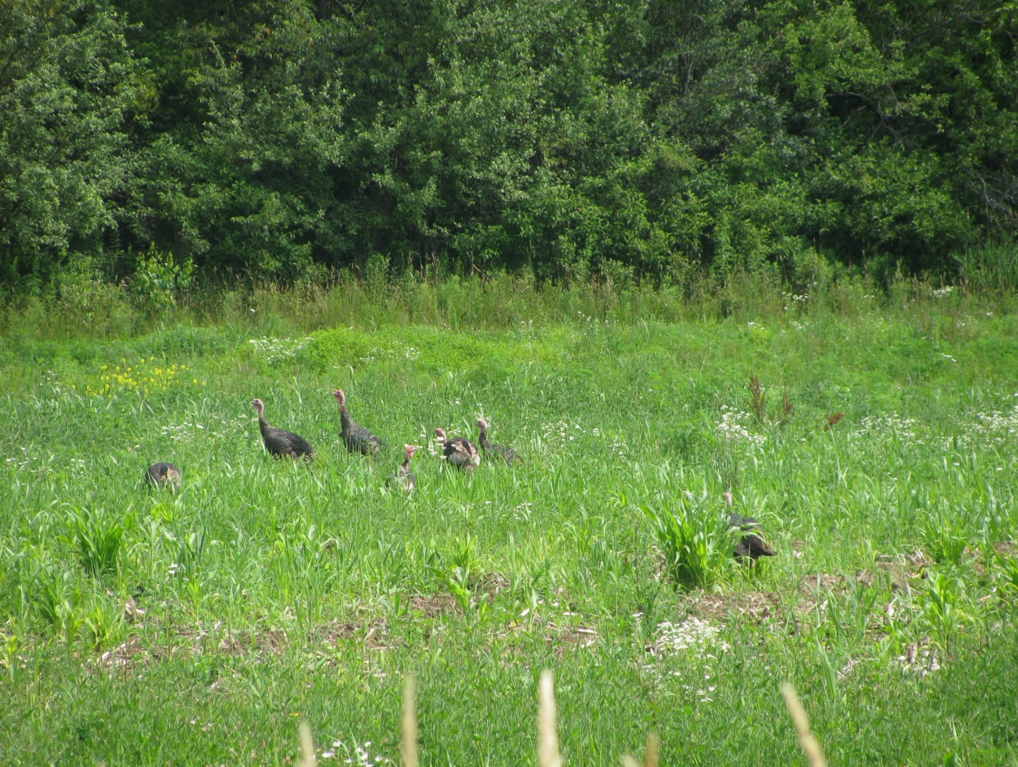
Increased Wildlife Activity
Increased wildlife activity
Since 2004, we have sprayed over 10,000 acres
Regeneration provides for Increased food sources
Several different flocks of turkeys were seen during our 2013 spraying project
During the time frame from 1976 thru 1998, I saw 2 black bears at Ft Drum
During our 2013 spraying project, I saw 5 different black bears
During our 2013 spraying project , I saw at least one deer on almost every trip in or out of our working area

Slide 21
Regal Fritillary Butterfly, (Endangered Species)
Regal Fritillary Butterfly
Goal of treatment – Increase the size of the butterfly habitat.
Pre treatment – total area available for butterfly habitat – 27 acres.
Post treatment - – total area available for butterfly habitat – 60 acres.

Slide 22
Contracting Options
Training Support System (TSS)
GSA
Service Disabled Partners
Small Business Partners
Native Hawaiian Organization (NHO)
Corps of Engineers
Department of Justice
MIPR

Slide 23
Thank You

